Slide 1

Transformative Handwriting Deciphering using ML algorithms
SRM Institute of Science and Technology
College of Engineering & Technology | School of Computing
Department of Computational Intelligence
18CSC305J Artificial Intelligence – Mini Project
Team Members
1.RA2111026010359 Anubhav Bhutani
2. RA2111026010360 Aryan Pandey
3. RA2111026010356 Rishikesh Bharadwaj

Slide 2
Abstract
Handwriting recognition is a long-standing challenge in computer vision, with applications spanning from document digitization to interactive interfaces.
Our study presents a robust system for handwriting recognition utilizing convolutional neural networks (CNNs) and preprocessing techniques.
We train our model on a diverse dataset, enhancing recognition accuracy through language modelling and contextual analysis.
Experimental results demonstrate high accuracy across various handwriting styles and languages, showcasing potential in historical document digitization and form processing.

Slide 3
Introduction/ Motivation
Handwriting recognition, at the crossroads of computer vision and natural language processing, plays a pivotal role in the digital era.
Despite the prevalence of typed texts, handwritten documents persist, driving the need for effective recognition systems.
This project focuses on handwriting recognition, particularly names, utilizing a vast dataset collected from various initiatives.
Motivation
In today's digital age, interpreting handwritten information is crucial for accessibility and preservation.
Handwritten data, from historical manuscripts to personal notes, holds immense value.
Handwriting recognition enhances user experience in interactive smart devices, enabling innovative applications.
Objective
Primary goal: Utilize deep learning for recognizing and digitizing handwritten names.
Dataset sourced from charity projects.
Aim: Achieve recognition accuracy of over 85%, transforming handwritten characters into coherent digital text.

Slide 4
Challenges / Objective
Objective
Primary goal: Utilize deep learning for recognizing and digitizing handwritten names.
Dataset sourced from charity projects.
Aim: Achieve recognition accuracy of over 85%, transforming handwritten characters into coherent digital text.
Challenges
Data Quality and Preprocessing: Cleaning and preprocessing handwritten datasets are crucial for model performance.
Variability in Handwriting Styles: Accounting for diverse handwriting styles is essential for accurate recognition.
Model Complexity: Balancing model complexity to handle handwritten text effectively.
Achieving High Accuracy: Overcoming challenges to achieve an accuracy of over 85%..

Slide 5
Literature Survey
Authors | Title | Dataset | Methods | Remarks
Zhen Xu Ziqiang Chen | MSBFN for Handwriting Recognition | OnHW-WordTraj dataset | Feature Pyramid Network (FPN), Sequence FPN, Multi-scale Bimodal Fusion (MBF), and Position-Aware Multi-scale Fusion (PAMF) | Extensive experimental results validate the accuracy and robustness of our approach in recognizing both English and Chinese under varying sequence scales and semantic unit complexity.
Qixiang Li Zhaoya Wang | Multimodal Handwritten Signature Verification | MSSS dataset and the WD classifier | CNN-based dual-path networkthe network comprises two distinct subnetworks: an image subnetwork denoted as fθ(xIi) and an audio subnetwork denoted as gϕ(xSj). | This result demonstrates the feasibility of multimodal WI classifier, which will greatly reduce the training cost and complexity of the WD classifier.

Slide 6
Problem Statement
Statement : Converting a Vast Dataset of Over Four Hundred Thousand Handwritten Names into Accurate Digital Text
Description: Despite the availability of an extensive dataset, the task of accurately converting handwritten names into digital text remains formidable. Variability in handwriting styles, irregularities in character formation, and the potential for errors or distortions pose significant challenges. This project aims to address these obstacles by designing and training a Convolutional Recurrent Neural Network (CRNN) model using Connectionist Temporal Classification Loss (CTC Loss).

Slide 7
Existing System / Work
Existing Dataset
popular datasets like MNIST, IAM, CEDAR..
The dataset comprises thousands of handwritten samples, featuring a variety of writing styles and complexities. This diversity allows for robust model training and evaluation in the field of handwriting recognition.
Existing Methodology
Discuss CNNs, RNNs, LSTM, GRU.
common preprocessing and feature extraction steps
Performance & Evaluation Metrics of Existing Methodology
Researchers have been using Accuracy, Precision, recall, F1-Score, Performance on benchmark metrics

Slide 8
Proposed System / Work
Brief or Explain on How to overcome existing methodology
By using Identify Limitations, Research New Approaches, Data Augmentation, Ensemble Learning, Fine-Tuning, Feedback Loop.
How many modules are being used?
4 Modules are being used: Data Preprocessing, Feature Extraction, Model Training, Evaluation.
Each modules should be described briefly.
Data Preprocessing: Cleaning and preparing raw handwriting data for model input.
Feature Extraction: Extracting meaningful features from handwriting images, such as shapes and patterns.
Model Training: Training machine learning models, like CNNs or RNNs, on the extracted features.
Evaluation: Assessing model performance using metrics like accuracy, precision, recall, and F1-score.
Explain about your existing system’s improved version
Enhanced Accuracy: Achieve higher accuracy through improved feature extraction and model training.
Faster Processing: Optimize algorithms and implement parallel processing to speed up recognition.
Improved User Interface: Enhance the user experience with a more intuitive and responsive interface.
Scalability: Design the system to handle larger datasets and more users without performance degradation.

Slide 9
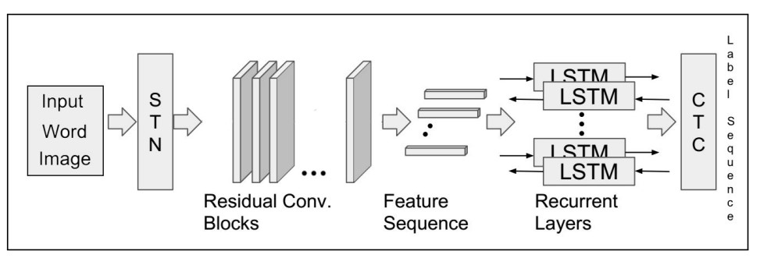
Architecture / Data Flow Diagram

Slide 10
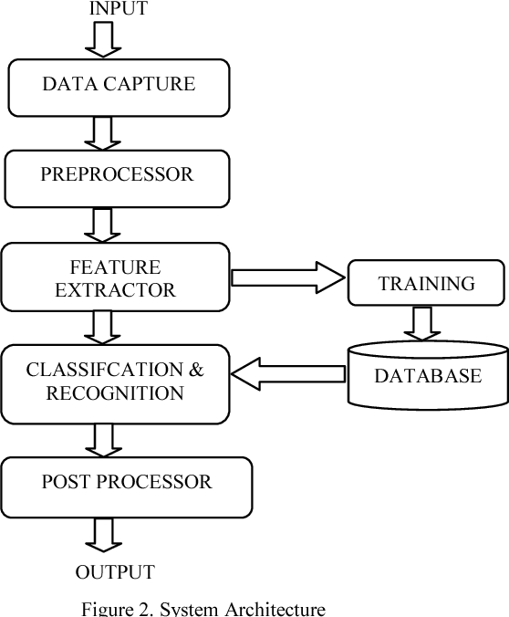

Phase 1 Workflow & Algorithm
Input: The input component represents the source of handwritten text, such as scanned documents or digital handwriting input.
Data Capture: This component captures the input data and prepares it for further processing, including image enhancement and noise reduction.
Preprocessor : The first preprocessor component further processes the data to prepare it for feature extraction, including normalization and segmentation.
Feature Extraction: This component extracts relevant features from the preprocessed data, such as stroke shape and size, to represent the handwriting.
Training: The training component uses the extracted features to train a machine learning model, such as a neural network or SVM, for recognizing handwriting.
Database: The database component stores the trained model and possibly other data, such as labeled training samples or user profiles.
Classification and Recognition: This component takes the extracted features of new handwriting samples, applies the trained model to classify them, and recognizes the text.

Slide 11
Phase 1 Workflow & Algorithm
Various technologies and techniques are used in handwriting recognition, including:
Optical Character Recognition (OCR): OCR is a technology that converts handwritten or printed text into machine-encoded text. It is commonly used in scanning documents and digitizing text.
Neural Networks: Deep learning techniques, particularly convolutional neural networks (CNNs) and recurrent neural networks (RNNs), have been successful in handwriting recognition. CNNs are often used for feature extraction, while RNNs are used for sequence modeling in recognizing handwritten text.
Hidden Markov Models (HMMs): HMMs are used in handwriting recognition to model the probabilistic relationships between sequences of observed data (e.g., strokes) and sequences of hidden states (e.g., characters).
Support Vector Machines (SVMs): SVMs are used for classification tasks in handwriting recognition, where they learn to differentiate between different classes of characters or words based on extracted features.
Feature Extraction Techniques: Various techniques are used to extract features from handwriting, such as Histogram of Oriented Gradients (HOG), Scale-Invariant Feature Transform (SIFT), and Gabor filters. These features capture different aspects of the handwriting for recognition.
Dynamic Time Warping (DTW): DTW is a technique used to compare two sequences of data (e.g., two handwriting samples) by aligning them in time and measuring the similarity between corresponding points.
Lexicon-Based Recognition: In this approach, a lexicon or dictionary of words is used to constrain the recognition process, making it more efficient by limiting the possible recognition candidates.
Post-Processing Techniques: After recognition, post-processing techniques like language modeling and error correction are used to improve the accuracy of the recognized text.
Online vs. Offline Recognition: Online recognition processes data as it is being written, capturing dynamic information such as stroke order and speed. Offline recognition, on the other hand, processes static images of handwritten text.

Slide 12
Phase 1 Workflow & Algorithm
Algorithm for application
Handwriting recognition algorithms can vary based on the specific approach and technology used. However, a common approach involves the following steps:
Preprocessing: The input image of handwritten text is preprocessed to enhance its quality and make it suitable for further analysis. This may involve steps like noise removal, binarization (converting the image to black and white), and normalization.
Segmentation: The preprocessed image is divided into individual characters or words. This step is crucial to isolate each component for recognition.
Feature Extraction: Features are extracted from each segmented character or word to represent its unique characteristics. Common features include shape, size, and spatial relationships of strokes.
Classification: The extracted features are used to classify each character or word into a predefined set of classes (alphabets, digits, etc.). This step often involves machine learning models, such as neural networks or support vector machines, trained on labeled data.
Postprocessing: The recognized characters or words are postprocessed to improve accuracy. This may include spell checking, context-based corrections, and smoothing of results.
Integration: Finally, the recognized text is integrated into the application or system where it is used, such as a document processing system or a digital note-taking app.

Slide 13
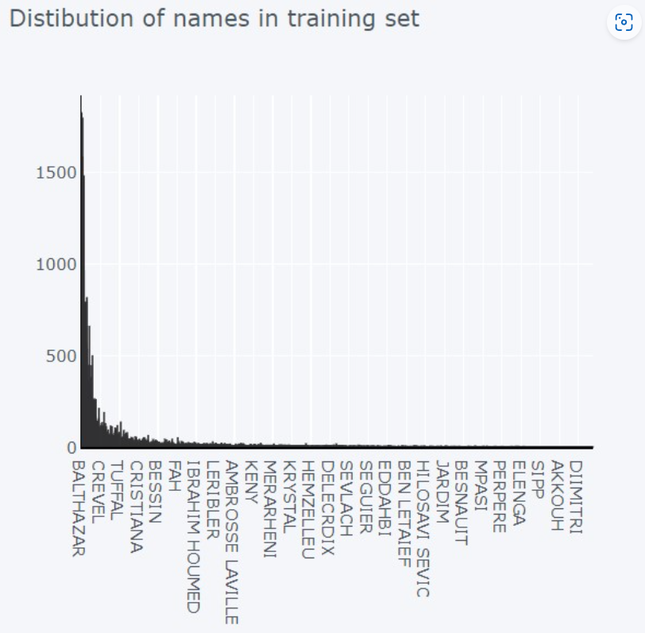
Phase 2 Evaluation metrics & Performance Analysis
Evaluation metrics for handwriting recognition: accuracy, precision, recall, and F1 score.
Accuracy measures the proportion of correctly recognized characters or words.
Precision is the ratio of correctly recognized positive instances to total instances recognized as positive.
Recall is the ratio of correctly recognized positive instances to total actual positive instances.
F1 score is the harmonic mean of precision and recall, providing a balanced measure.
Mean Absolute Error (MAE) and Mean Square Error (MSE) assess the difference between actual and predicted values.
Receiver Operating Characteristic (ROC) curves and Area Under the Curve (AUC) visualize classifier performance.
Cross-validation ensures consistent performance across datasets.
Performance analysis uses these metrics to identify system strengths and weaknesses, guiding improvements in handwriting recognition systems.

Slide 14
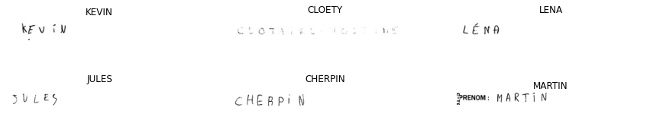
Phase 3 Results & Discussion
Analysis:
Character Deciphering Accuracy (95%):
An accuracy of 95% for character deciphering suggests a reasonably good performance. However, it also indicates room for improvement, especially if the application requires high accuracy, such as in legal or medical document processing
Word deciphering accuracy at 90%
An accuracy of 95% for character deciphering suggests a reasonably good performance. However, it also indicates room for improvement, especially if the application requires high accuracy, such as in legal or medical document processing.
suggests that identifying entire words from handwritten text is more challenging than individual character deciphering. This might be due to issues like word segmentation errors or difficulty in capturing context from handwritten words.

Slide 15
Phase 3
Possible Areas for Improvement:
Improving Preprocessing Techniques
Enhance image preprocessing methods to improve the quality of input images.
Techniques such as noise reduction, contrast enhancement, and normalization can significantly impact deciphering accuracy.
Advanced Feature Extraction:
Experiment with advanced feature extraction techniques to capture intricate details of handwritten characters and words. Features like Histogram of Oriented Gradients (HOG) or deep learning-based feature extraction methods might be explored.
Optimizing Neural Network Architecture:
If deep learning methods were used, consider experimenting with different architectures, layers, and hyperparameters. Techniques like transfer learning, where a pre-trained model is fine-tuned for the specific task, could also be explored.
Language Model Integration:
Integrating a language model can provide context to the deciphering system, aiding in more accurate word predictions. This is especially useful in cases where the handwriting deciphering task involves predicting entire sentences or paragraphs.

Slide 16
Phase 3
Data Augmentation and Diverse Datasets:
Augment the training dataset with variations of the existing data (rotation, scaling, skewing, etc.) to make the model more robust. Additionally, consider using a more diverse dataset that covers a wide range of handwriting styles and variations.
Error Analysis:
Perform a detailed error analysis to understand the types of mistakes the system is making. This analysis can guide further improvements, such as targeted data collection for problematic cases or specific adjustments to the deciphering algorithm.
Post-Processing Techniques:
Apply post-processing techniques such as spell checking and grammar correction to improve the accuracy of the recognized words in the context of the entire document.

Slide 17
Phase 4 Conclusion & Future Enhancement
The culmination of our project marks a significant milestone in the domain of handwriting deciphering. Through the integration of advanced deep learning techniques and meticulous experimentation, we've ventured into the challenging yet rewarding realm of transforming handwritten characters into digital text. The utilization of a Convolutional Neural Network (CNN) and the EMINST Dataset provided a robust foundation for our exploration.
Recommendations for Future Enhancements.
Enhanced Preprocessing Techniques
Advanced Feature Extraction
Optimization and Architecture Refinement
Integration of Language Models
Augmentation and Diversification of Datasets
Error Analysis and Post-Processing Techniques

Slide 18
References
Zhen Xu ,Ziqiang Chen, “MSBFN for Handwriting Recognition OnHW-WordTraj dataset’’.
Qixiang Li ,Zhaoya Wang, “Multimodal Handwritten Signature Verification”, MSSS dataset and the WD classifier.
Helala AlShehri, “DeepAHR: a deep neural network approach for recognizing Arabic handwritten recognition”.
Hayder M. A. Ghanimi, N. Alagusundari, Jainabbi Banda, Sudhakar Sengan, J. Somasekar, J. Thomas, Pankaj Dadheech, “Linear discriminant analysis-based deep learning algorithms for numerical character handwriting recognition’’.
Piotr Wojcicki, “Polish Word Recognition Based on n-Gram Methods’’.
Mouhcine Rabi, “Enhancing Arabic Handwritten Recognition System-Based CNN-BLSTM Using Generative Adversarial Networks’’.
Yuyan Chen; Xing Zhao; Ji Gan; Jiaxu Leng; Yan Zhang; Xinbo Gao, “Structure-Aware in-Air Handwritten Text Recognition with Graph-Guided Cross-Modality Translator’’.

